Slide 1
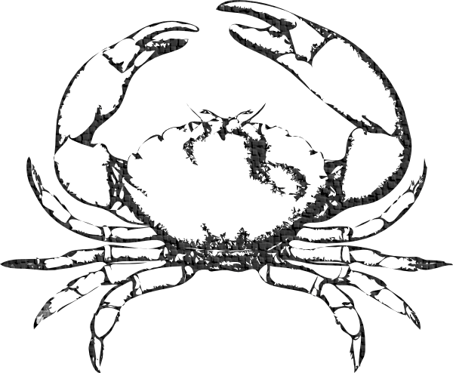
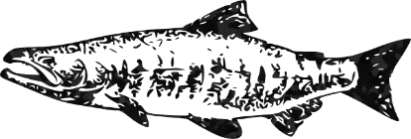
Invertebrate
Vertebrate
Common organs for sample collection*
Gills, heart, muscle and/or foot, gastro-intestinal system (may be simple digestive gland or cecae depending on organism), reproductive organs or tissues, epidermis, esophagus, mantle, antennal gland, hematopoietic tissue, brain; as present (see 2,3,4,6, 7)
Common organs for sample collection
Hematopoietic tissue, spleen, thymus, heart, thyroid, gills, kidney, gastrointestinal system, GI contents, reproductive organs, brain and specialized sensory and endocrine organs, eye, pseudobranch, urine, bile, adrenal glands, liver, gallbladder, choroid rete, musculoskeletal system, and skin; as present (see 1, 2, 5)
Sample Preservation Methods
Histology: modified Davidson’s or 10% buffered formalin
Electron Microscopy: 2.5% glutaraldehyde buffered in 0.1 M sodium cacodylate
Genomics (DNA): freezing (-20 °C , -80 °C, or flash frozen) or ethanol preservation
Transcriptomics (RNA): RNA stabilization solution or flash freezing
Culture appropriate media or flash freezing for some viral isolation
Metadata
Environment: date, location (latitude/ longitude or GPS coordinates), time of collections, habitat/ substrate type, weather conditions, tidal conditions, recent storm events, tidal zone, air temperature, water temperature, salinity, dissolved oxygen levels, visibility, phytoplankton blooms, water clarity, presence of contaminants, recent human activity (i.e. fishing), etc.
Population: species (impacted and also unaffected), associated community members, number of animals involved, wild and or aquaculture species
Organism: size, age, reproductive condition, abnormal behavior (lethargy, erratic swimming/ movement, respiratory distress), gross signs (discoloration, lesions, hemorrhaging, excessive mucus production), if outward disease signs present: severity & prevalence
Other important data: Names, agencies and contact information for sample collectors and investigators, detailed sample information on collection containers including fixative, possibly chain of custody forms to accompany samples, photo documentation
*organs vary in form and structure in invertebrates and in some cases whole animals or simple cross sections may be sufficient, particularly in clonal animals or small specimens
Notes:
Figure 3. Field guide to collection of marine disease samples

