Slide 1
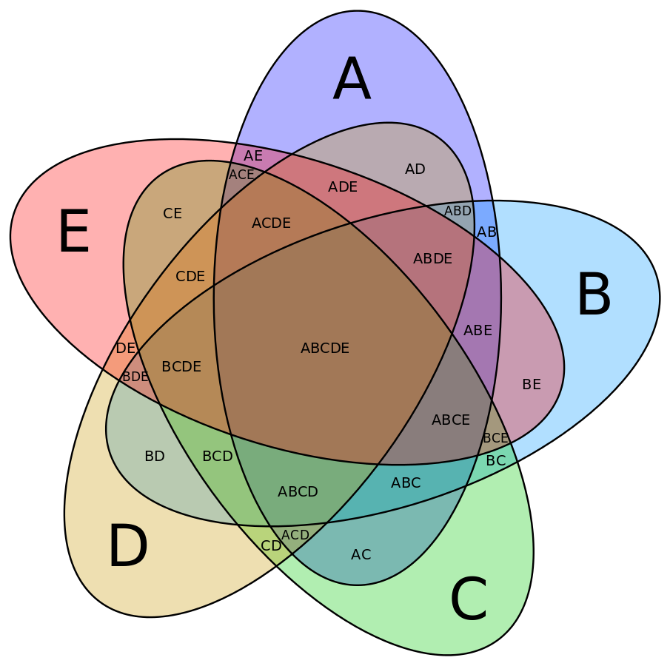
Additional file 2 – Venn diagram showing the distribution of the 1111 OTUs among the intestinal samples of the five experimental groups.
LH1-LH2
146
35
14
7
9
HG1-HG2
140
29
10
6
18
9
3
C1-LH2
159
2
31
42
3
30
10
8
6
25
1
25
5
7
C1-HG2
135
6
21
34
C1-C2
135

