Slide 1
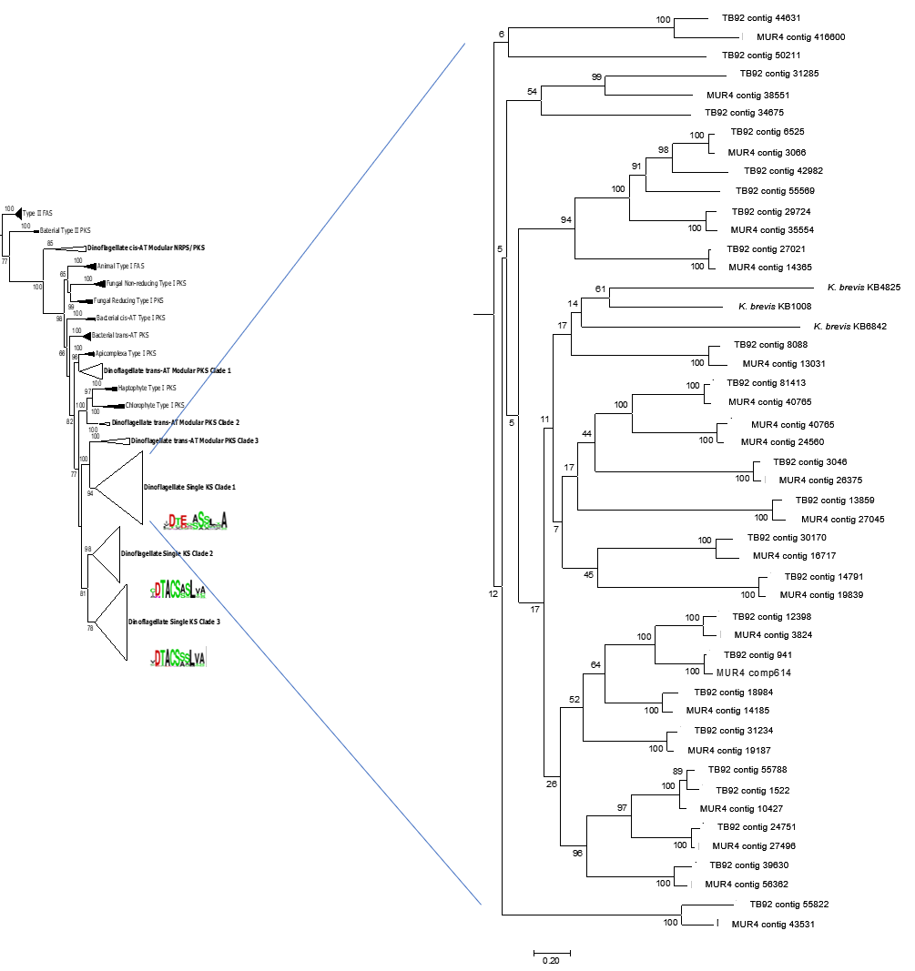
Single Domain Clade 1
S1_Fig.

Slide 2
Single Domain Clade 2

Slide 3
Single Domain Clade 3

