Slide 1
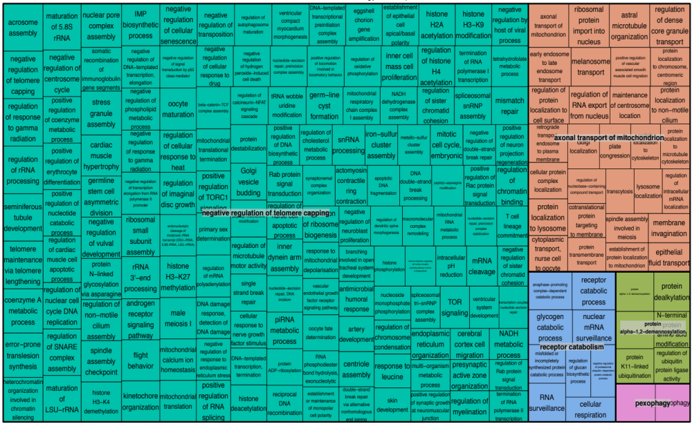
Supplementary Figure 1A

Slide 2
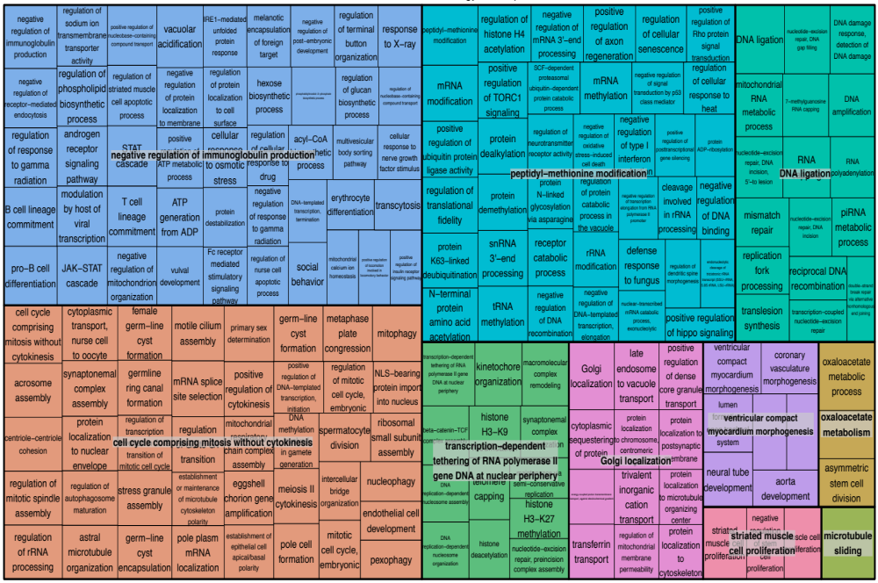
Supplementary Figure 1B

Slide 3
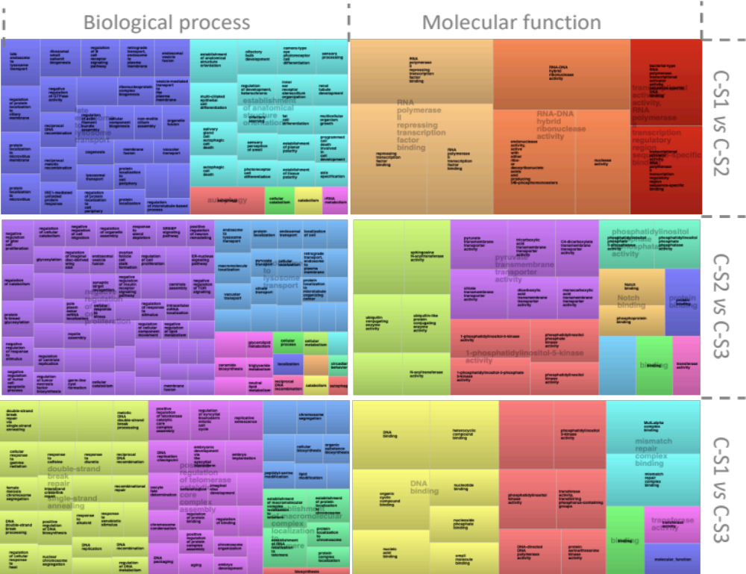
Supplementary Figure 2

