Slide 1
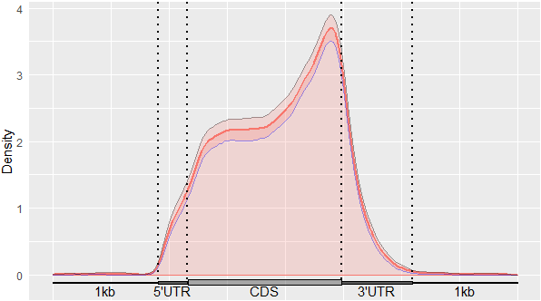
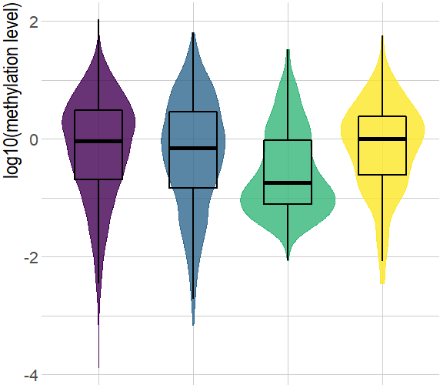
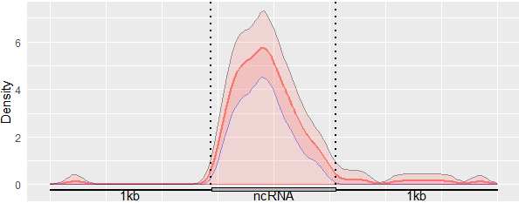
A
B
mRNA
D
a
a
b
ab
lncRNA
mRNA lncRNA DNA TE RNA TE
C
P value = 1E‒464
Notes:
Figure 1: N⁶-methyladenosine signatures of oyster RNA classes.
A: m⁶A distribution among RNA classes (mRNA, messenger RNA, lncRNA, long non-coding RNA; DNA TE, DNA transposable element RNA; RNA TE, RNA transposable element RNA; misc. RNA, miscellaneous RNA; tRNA, transfer RNA). Diagram diameter was normalized between RNA classes. B. m⁶A localization along mRNAs and ncRNAs. UTR, untranslated region; CDS, coding sequence; kb, kilobase. C. Consensus sequence of the m⁶A motif in the oyster identified by HOMER. D. Violin plot of the mean methylation level of the methylated transcripts of mRNA, lncRNA, DNA and RNA (n=) TE classes during oyster development. Letters discriminate significantly different methylation levels (ANOVA followed by Bonferroni’s post hoc test, p<0,05).. E: Egg, FE: Fertilized egg, 2/8C: Two to eight cells, M: Morula, B: Blastula, G: Gastrula, T: Trochophore, D: D-larva, P: Pedeveliger, S: Spat. mRNA (messenger RNA), lncRNA (long non coding RNA), DNA TE (DNA transposable element), RNA TE (RNA transposable element), misc. RNA (miscellaneous RNA), tRNA (transfer RNA).

Slide 2
A
mRNA
lncRNA
B
mRNA
m⁶A enriched
35.8%
m⁶A enriched
11.1%
m⁶A detected
91.0%
m⁶A detected
65.7%
D
a
a
b
ab
transcribed
pseudogene
misc_RNA
m⁶A enriched
72.7%
m⁶A enriched
18.7%
Log₁₀ Methylation level
lncRNA
m⁶A detected
100%
m⁶A detected
75%
tRNA
m⁶A detected
4.4%
mRNA lncRNA DNA TE RNA TE
RNA TE
DNA TE
C
m⁶A detected
87.6%
m⁶A detected
99.4%
P value = 1E^{‒464}
Notes:
Figure 1: N⁶-methyladenosine signatures of oyster RNA classes.
A: m⁶A distribution among RNA classes (mRNA, messenger RNA, lncRNA, long non-coding RNA; DNA TE, DNA transposable element RNA; RNA TE, RNA transposable element RNA; misc. RNA, miscellaneous RNA; tRNA, transfer RNA). Diagram diameter was normalized between RNA classes. B. m⁶A localization along mRNAs and ncRNAs. UTR, untranslated region; CDS, coding sequence; kb, kilobase. C. Consensus sequence of the m⁶A motif in the oyster identified by HOMER. D. Violin plot of the mean methylation level of the methylated transcripts of mRNA, lncRNA, DNA and RNA (n=) TE classes during oyster development. Letters discriminate significantly different methylation levels (ANOVA followed by Bonferroni’s post hoc test, p<0,05).. E: Egg, FE: Fertilized egg, 2/8C: Two to eight cells, M: Morula, B: Blastula, G: Gastrula, T: Trochophore, D: D-larva, P: Pedeveliger, S: Spat. mRNA (messenger RNA), lncRNA (long non coding RNA), DNA TE (DNA transposable element), RNA TE (RNA transposable element), misc. RNA (miscellaneous RNA), tRNA (transfer RNA).

Slide 3
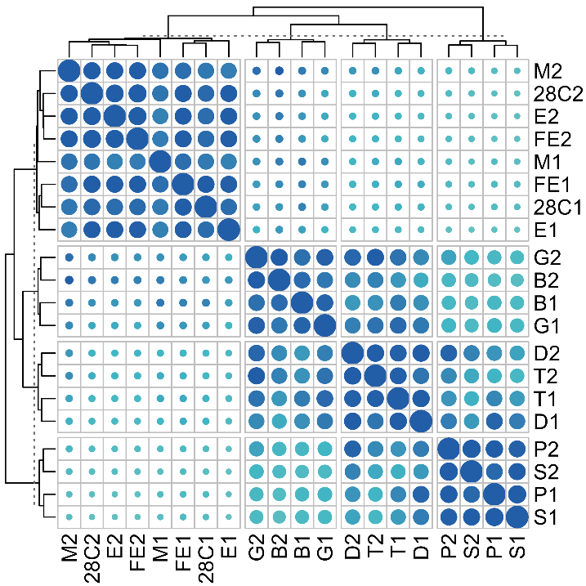
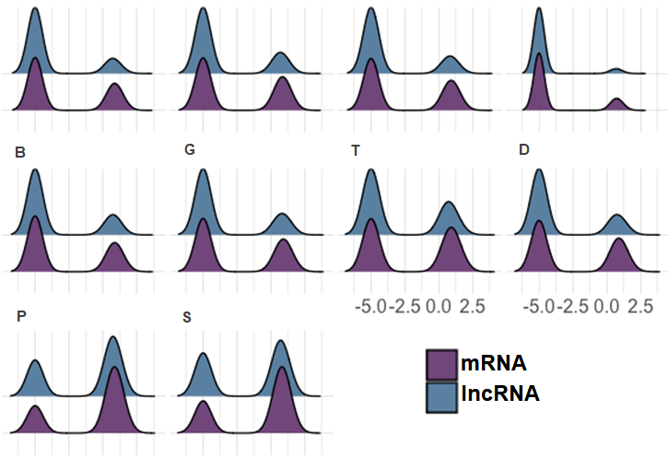
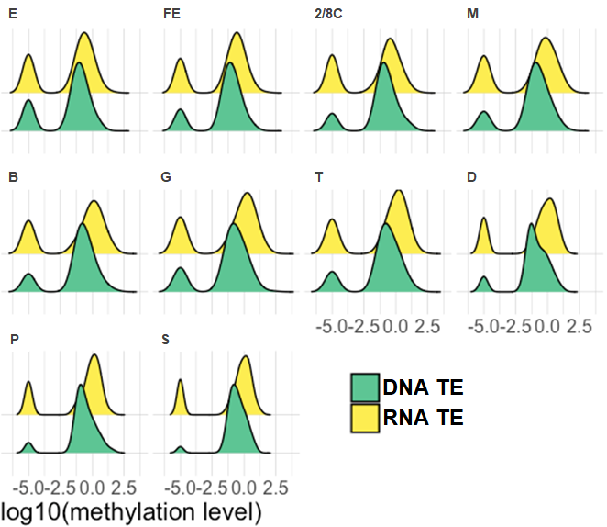
A
B
Oocyte
(E)
Development chronology
Juvenile
(S)
17
Developmental phase
Cleavage
Cleavage
10
Gastrulation
0
Tissue differentiation
PC2, 8.5% variation
Metamoprhosis
Gastrulation
-10
Sampling1
Tissue differentiation
-22,5
Sampling2
Metamorphosis
-26
-20
0
20
-29
PC1, 16.7% variation
C
E
FE
2/8C
M
D
E
FE
2/8C
M
G
T
D
B
G
T
D
B
v
v
-5.0
-2.5
0.0
2.5
-5.0
-2.5
0.0
2.5
P
S
-5.0
-2.5
0.0
2.5
-5.0
-2.5
0.0
2.5
P
S
v
v
-5.0
-2.5
0.0
2.5
-5.0
-2.5
0.0
2.5
-5.0
-2.5
0.0
2.5
-5.0
-2.5
0.0
2.5
Log₁₀ methylation level
Log₁₀ methylation level
Notes:
Figure 2: Epitranscriptome dynamics during oyster development.
A. Principal component analysis of MeRIP-seq results. PCA plot of the first two principal components of the MeRIP-seq results for each developmental sample of the two distinct experiments. B. Similarity (pairwise Pearson’s correlation matrix) of m⁶A-methylation between samples based on IP/Input signal (see methods). C. Dynamics of the m⁶A-methylation level of the mRNA (purple) and lncRNA (blue) transcripts. All the transcripts found m⁶A-enriched over background using MetPeak are represented. Areas under the curve are normalized for each RNA class. Undetectable methylation was arbitrarily affected a -5 value for representation purpose. D. Dynamics of the m⁶A-methylation level of the DNA TE (green) and RNA TE (yellow) transcripts. All the transcripts whose methylation was detected in at least one stage are represented on the density plots. Areas under the curve are normalized for each RNA class. Undetectable methylation was arbitrarily affected a -5 value for representation purpose. E: Egg, F E: Fertilized egg, 2/8C: Two to eight cells, M: Morula, B: Blastula, G: Gastrula, T: Trochophore, D: D larvae, P: Pediveliger, S: Spat.
E: Egg (oocyte), FE: Fertilized egg, 2/8C: Two to eight cell-stage, M: Morula, B: Blastula, G: Gastrula, T: Trochophore, D: D-larva, P: Pedeveliger, S: Spat. mRNA (messenger RNA), lncRNA (long non coding RNA), DNA TE (DNA transposable element), RNA TE (RNA transposable element).

Slide 4
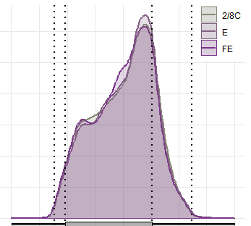
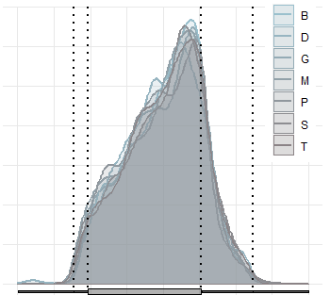
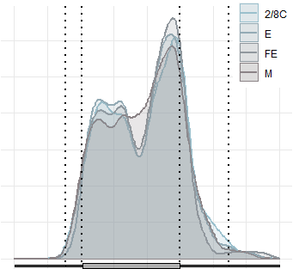
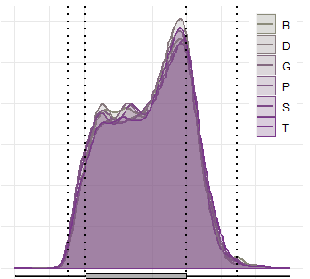
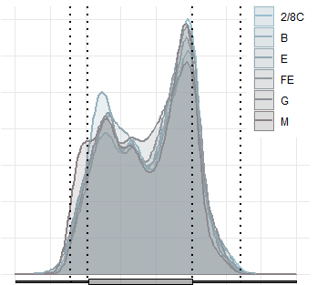
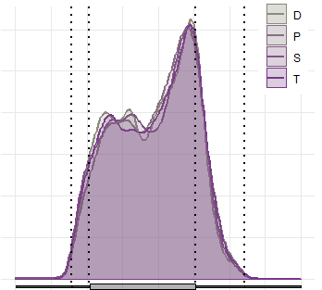
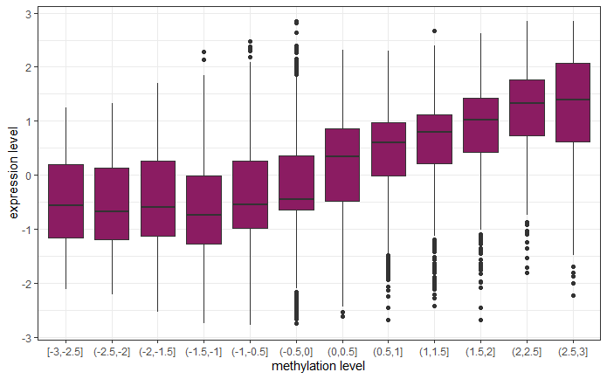
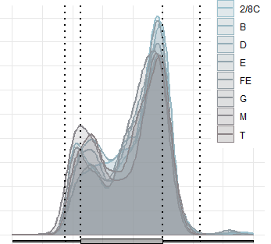
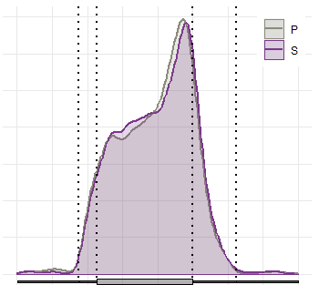
A
C
2/8C
B
D
3
E
3
D
Cluster 1
FE
G
Cluster 1
M
1.00
P
2
2
S
Cluster 1
T
0.75
Cluster 2
1
1
0.50
0.25
0
0
0.00
Cluster 3
Expression level
2/8C
3
B
4
3
E
D
Cluster 2
2
FE
G
1.00
0
M
P
-2
2
2
S
0.75
-4
Cluster 2
T
Methylation level
1
0.50
Cluster 4
4
1
0.25
2
Density
0
0
0
0.00
6
-2
D
5
-4
2/8C
3
P
Cluster 3
4
3
B
S
3
E
E
1.00
2
E
FE
M
B
G
T
D
P
S
FE
M
B
G
T
D
P
S
2/8 C
2/8 C
FE
T
1
G
2
0.75
0
B
3
2
M
P value = 2.22x10^{₋16}
Cluster 3
0.50
2
1
1
0.25
0
0.00
1
0
2/8C
P
Cluster 4
4
B
S
1.00
Expression level
D
3
0
E
3
FE
0.75
-1
G
2
Cluster 4
M
P value
Density
T
0.50
2
-2
1
0.25
1
0.00
-3
0
0
0.00
0.25
0.50
0.75
1.00
1kb
0
5’
UTR
5’
UTR
CDS
CDS
3’
UTR
1kb
1kb
[-3,-2.5]
(-2.5,-2]
(-2,-1.5]
(-1.5,-1]
(-1,-0.5]
(-0.5,0]
(0,0.5]
(0.5,1]
(1,1.5]
(1.5,2]
(2,2.5]
(2.5,3]
5’
UTR
CDS
3’
UTR
1kb
R²
Methylation level
Notes:
Figure 3: Dynamics of mRNA expression and m⁶A methylation during oyster development.
A. Heat map of normalized expression (blue) and m⁶A content (purple) of significantly methylated mRNA genes during oyster development. Transcript variants were pooled for each gene. Values are log-centered reduced (n=1494). The development stages are indicated below. B. Correlation between expression (Y axis ) and methylation (X axis) levels. The methylation level was divided into twelve quantiles. C. Methylation profiles of mRNAs displaying high (pink) or low (grey) expression within each cluster. The development stages constitutive of high and low expression groups within each cluster are indicated. D. Correlation plot of expression vs. methylation dynamics throughout development. The linear correlation of the methylation vs. expression variation was assessed for each gene across oyster development per cluster and the results are given as surface plots (R-square, X-axis; p-value, Y axis, density of genes, Z axis). E: Egg (oocyte), FE: Fertilized egg, 2/8C: Two to eight cell-stage, M: Morula, B: Blastula, G: Gastrula, T: Trochophore, D: D-larva, P: Pedeveliger, S: Spat.

Slide 5
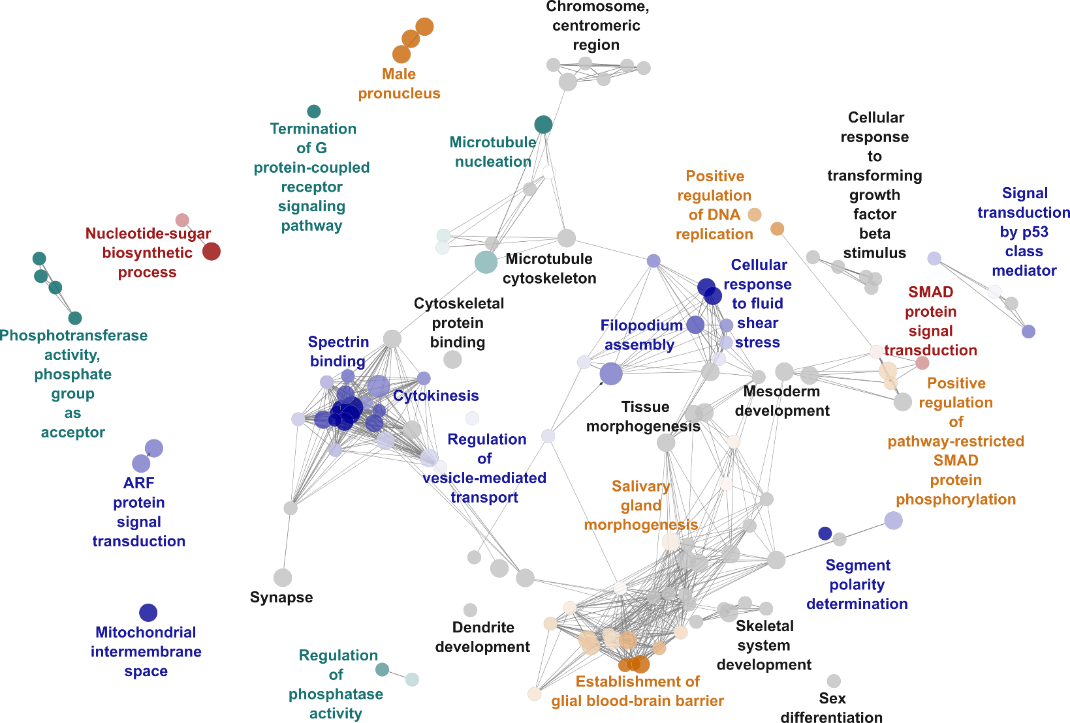
Cluster 1
Cluster 2
Cluster 3
Cluster 4
Common
Notes:
Figure 4: Functional annotation of differentially methylated mRNAs during oyster development
Enriched Gene Ontology terms (hypergeometric test, FDR<0.05) associated to differential m⁶A mRNA methylation across oyster development. Enriched terms corresponding to specific clusters are coloured, common terms between clusters are black. Colour intensity is relative to cluster specificity, with colour limit set to 51% of genes inside the respective cluster. Circle diameter correspond to the pvalue of the enrichment.

Slide 6
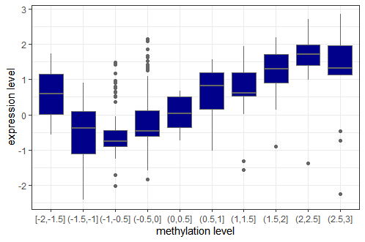
C
Cluster 1
A
0.75
Cluster 1
0.50
B
3
P value = 1.07x10 ^{₋45}
0.25
Cluster 2
2
0.00
1
Cluster 2
Expression level
0.75
Density
Expression
level
0
6
4
0.50
5
2
4
0
-1
0.25
3
-2
2
Cluster 3
-4
1
-2
0.00
0
Methylation
level
Cluster 3
4
[-2,-1.5]
(-1.5,-1]
(-1,-0.5]
(-0.5,0]
(0,0.5]
(0.5,1]
(1,1.5]
(1.5,2]
(2,2.5]
(2.5,3]
2
Methylation level
0.75
0
-2
-4
P value
0.50
E
FE
M
B
G
T
D
P
S
E
FE
M
B
G
T
D
P
S
0.25
2/8 C
2/8 C
0.00
0.00
0.25
0.50
0.75
1.00
R²
Notes:
Figure 5: Dynamics of lncRNA expression and m⁶A methylation during oyster development.
A. Heat map of normalized expression (blue) and m⁶A content (light blue) of significantly methylated lncRNA genes during oyster development. Transcript variants were pooled for each gene. Values are log-centered reduced. B. Correlation between expression (Y axis ) and methylation (X axis) levels. The methylation level was divided into ten quantiles. C. Correlation plot of expression vs. methylation dynamics throughout development. The linear correlation of the methylation vs. expression variation was assessed for each gene across oyster development per cluster and the results are given as surface plots (R-square, X-axis; p-value, Y axis, density of genes, Z axis). E: Egg (oocyte), FE: Fertilized egg, 2/8C: Two to eight cell-stage, M: Morula, B: Blastula, G: Gastrula, T: Trochophore, D: D-larva, P: Pedeveliger, S: Spat.

Slide 7
A
B
TE class (proportion of transcripts methylated in class / proportion in the genome / proportion of the TEs investigated )
1.68 %
3.93 %
10.12 %
LTR (85.5% / 1.85% / 39.1%)
TIR (92.6% / 3.79% / 16.1%)
LINE (100% / 2.12% / 44.7%)
Helitron (88.5% / 12.4% / 53%)
DIRS (100% / 0.29% / 6.1%)
37.13 %
Crypton (100% / 2.84% / 12%)
31.46 %
Penelope (100% / 0.46% / 9.8%)
Kolobok (100% / 1.78% / 7.5%)
32.50 %
62.93 %
20.25 %

Slide 8
A
c-myc
klf
mettl3
oct4
c-myc
klf
mettl3
oct4
hnrnpa2b1
hnrnpa2b1
B
c-myc
klf
mettl3
oct4
c-myc
klf
mettl3
oct4
hnrnpa2b1
hnrnpa2b1
Notes:
Figure S1: Validation of m6A immunoprecipitation transcripts
A. Relative methylation (left) and expression level (right) of targeted transcripts c-Myc, Klf, Mettl3, hnrnpA2B1 and Oct4 quantified by MeRIP-qPCR (left) and RT-qPCR (right) on a pool of RNA from oyster development stages (see methods). The dotted line represents the threshold for m⁶A-RNA enrichment. B. Methylation (left) and expression level in TPM (right) of targeted transcripts c-Myc, Klf, Mettl3, hnrnpA2B1 and Oct4 quantified by MeRIP-seq (left) and RNA-seq (right) on a pool of oyster development. Error bars represent the standard deviation from two independent biological replicates (n=2).

Slide 9
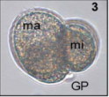
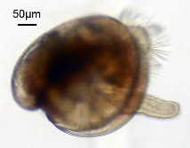
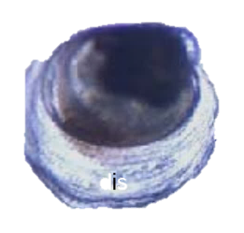
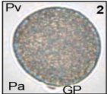
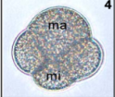
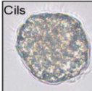
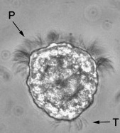
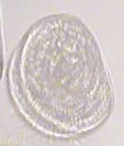
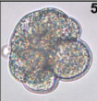
Stage :
Adult broodstock
Oocyte
Fertilized egg
2/8 cells
Morula
Blastula
Gastrula
Trochophore
D Larva
Pediveliger
Spat
Experiment 1 (Feb. 2019):
n=126; 3 – 6 years old
(47 males – 79 females)
Experiment 2 (March 2019):
n=140; 3 – 6 years old
(84 males – 56 females)
Fertilization
Larval
settlement
Gonad stripping
Metamorphosis
Water volume:
(UV–treated, 1µm filtered SSW)
5 l
150 l, oxygenated
Downwelling system
Time post fertilization at 21°C:
N/A
0 min
1 – 1.5 h
4 h
6 h
10 h
16 h
24 h
20 d
25 d
Amount per sample:
1 million
1 million
1 million
1 million
1 million
1 million
1 million
1 million
100 mg
100 mg

