Slide 1
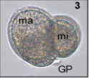
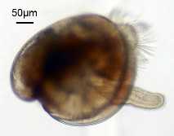
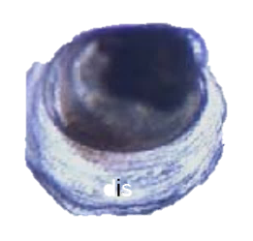
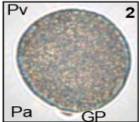
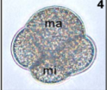
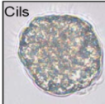
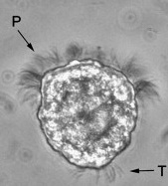
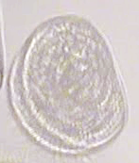
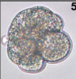
Stage :
Adult broodstock
Oocyte
Fertilized egg
2/8 cells
Morula
Blastula
Gastrula
Trochophore
D Larva
Pediveliger
Spat
Experiment 1 (Feb. 2019):
n=126; 3 – 6 years old
(47 males – 79 females)
Experiment 2 (March 2019):
n=140; 3 – 6 years old
(84 males – 56 females)
Fertilization
Larval
settlement
Gonad stripping
Metamorphosis
Water volume:
(UV–treated, 1µm filtered SSW)
5 l
150 l, oxygenated
Downwelling system
Time post fertilization at 21°C:
N/A
0 min
1 – 1.5 h
4 h
6 h
10 h
16 h
24 h
20 d
25 d
Amount per sample:
1 million
1 million
1 million
1 million
1 million
1 million
1 million
1 million
100 mg
100 mg

